Slide 1
Characteristics of Successful Entrepreneur
Creativity, Source of New Idea, Ideas into Opportunities

Slide 2
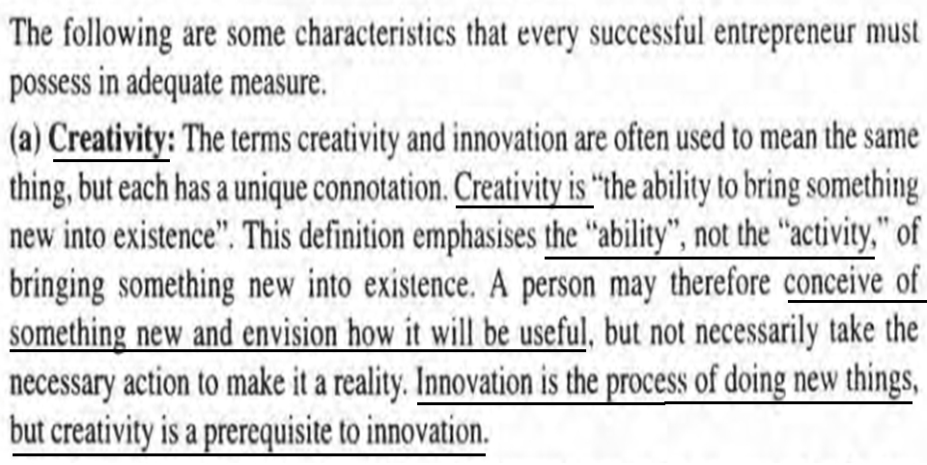

Slide 3
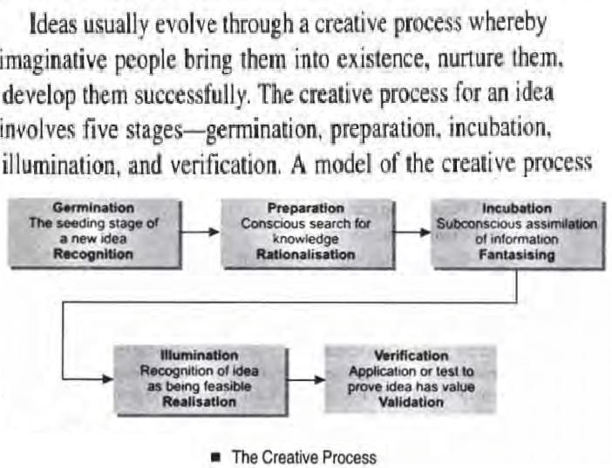

Slide 4
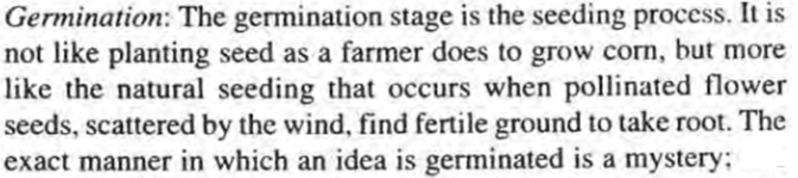
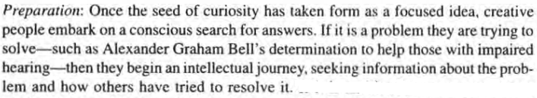

Slide 5
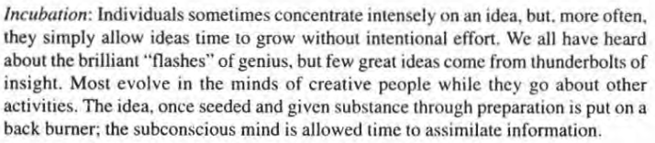
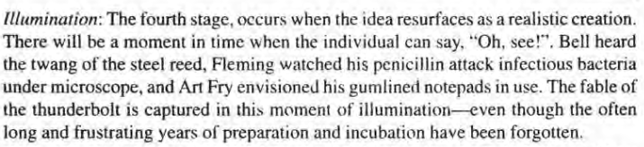

Slide 6
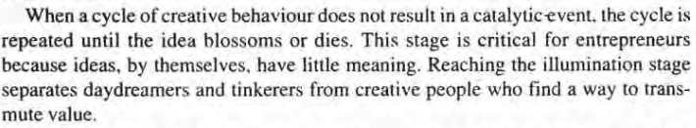
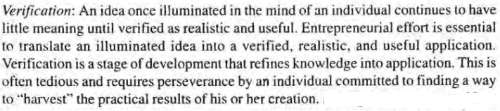

Slide 7
Innovation
Entrepreneurs innovate Innovation is the specific instrument of entrepreneurship.
Innovation, indeed, creates a resource, convert a "material" into a "resource'·, or to combine existing resources in a new and more productive configuration with a capacity to create wealth.
Then he will be successful entrepreneur even though their individual motivation be a money, power, curiosity, or ultimately desire for fame and recognition.
There are chances for the unit to grow from small to large unless the entrepreneur should be futuristic and innovative.

Slide 8
Innovation
Innovation could be the result of positive refluxes or continuous and spontaneous thought processes.
The entrepreneur should be constantly in search of the changes in the environment to find answers to issues confronting him.
At a particular point of time, the government policy may favor one method or another, but with changes in environment.
For an innovator, the market is never too saturated.
It can be a totally new concept of commodity or an improvement in the design and specifications of a product.
It may be a new method for reducing the cost of production.
Entrepreneur-managers must always encourage and nourish new ideas about every aspect of business.

Slide 9
Systematic innovation
The meaning is to monitoring following 7 sources for innovative opportunity -
The unexpected-unexpected success, unexpected failure, unexpected outside event.
The incongruity-between reality as it actually is and reality as it is assumed to be or as it "ought to be"
Innovation based on process need
Changes in industry structure or market structure that catches everyone unawares
Demographics (population changes)
Changes in perception, mood, and meaning
New knowledge-scientific and non-scientific

Slide 10
Creative Problem Solving
Entrepreneurs have a high need for achievement and arc guided by their inner self. motivating their behavior towards accomplishment.
In India, we have a number of such entrepreneurs who started their business activity from scratch.
Jamnalal Bajaj was also considered as a great pioneer and first generation entrepreneur in the Bajaj family. Charat Ram and Bharat Ram, who started their careers at the bottom of the buffing coal into boilers and washing floors.
Business families of Tata. Birla. Mafatlal. Singhania. Kirloskar. Bajaj. Firodia and a host of others were really pathfinders and pioneers in their respective fields.

Slide 11
